Slide 1
Understanding the McKinney-Vento Assistance Act
Presented by Dr. Jennifer Kottke
Los Angeles County Office of Education
Educating Students Experiencing Homelessness
~Parent Focused Presentation~
May 18, 2022
Notes:
NOTE:
To change the image on this slide, select the picture and delete it. Then click the Pictures icon in the placeholder to insert your own image.

Slide 2







Homelessness in California Has Many Faces

Slide 3

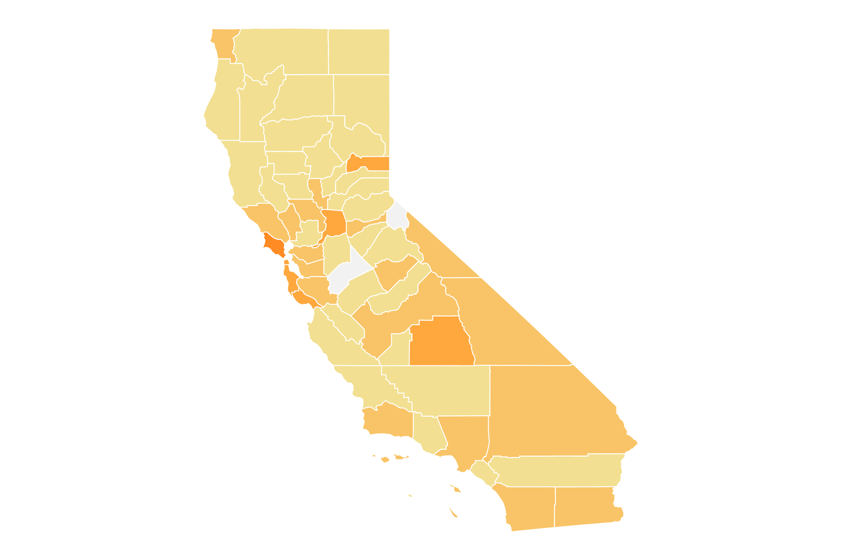
LAWS & RIGHTS
State Laws
Federal Laws
Education Code – enforces the McKinney-Vento Assistance Act
McKinney-Vento Assistance Act

Slide 4
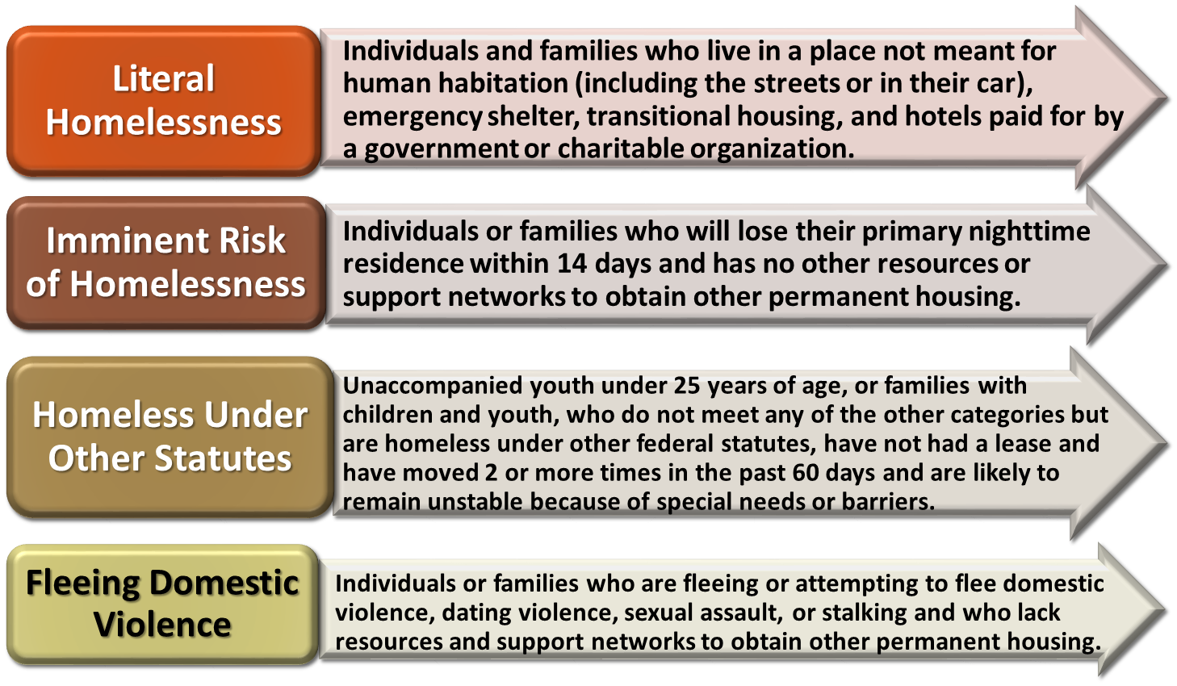
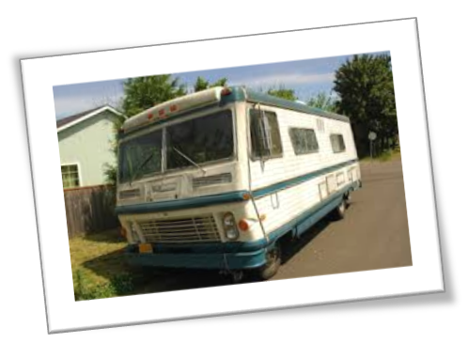
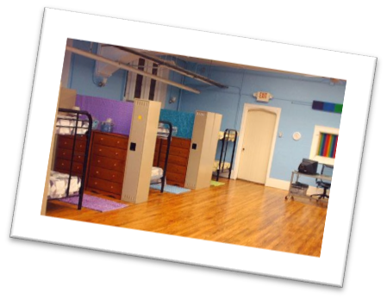

McKinney-Vento Homeless Act Definition
BOTH FEDERAL LAWS!
Housing and Urban Development (HUD) Definition
Determining “Fixed”
  A fixed residence is one that is stationary, permanent and not subject to change
Determining “Regular”
  A regular residence is one that is used on a regular basis [i.e. nightly]
Determining “Adequate”
  An adequate residence is one that is sufficient for meeting both the physical and psychological needs typically met in home environments
Los Angeles County Office of Education

Slide 5
LAWS & RIGHTS
McKinney-Vento
HUD (Housing & Urban Development)
Focused on EDUCATION
Remove barriers for education and provide referrals including referrals to HUD for housing
Do not house, typically
Focused on HOUSING
Work with families and youth to resolve housing related concerns
May reach out to education for support to connect back to school
HUD
McK

Slide 6
Who falls under McKinney-Vento?
Fixed?
Stationary, Permanent, & Not Subject to Change
Regular?
Used on a Regular Basis (i.e. nightly)
Adequate?
Sufficient for Both Physical & Psychological Needs
Los Angeles County Office of Education

Slide 7
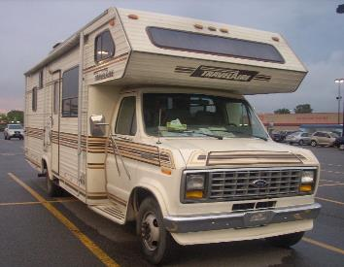
FIXED
Is the location on wheels? Does it move to various locations?
Does the family have any legal right to be in that home?
Is the arrangement permanent or temporary or is the family seeking another place to live?
Did the families move in together to save money? Is this a permanent plan?
How soon does the family plan to move?
What brought the family to the current living situation? Where was the family living previously?
Where would the family go if they could not stay in their current location?
Could the family be asked to leave at any time?
Is the housing shared equally?

Slide 8

REGULAR
Does the family move frequently or does the family stay in the same place each night?
Does the family have a key to the place they are staying? Can the family come and go freely?
How long has the family been there?
How long did they live in the last place? Why did the family leave?
Is the family staying together at night or splitting up?
A COUCH IS NOT A HOME

Slide 9
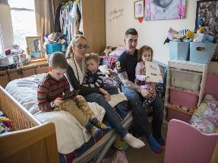
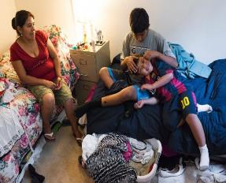
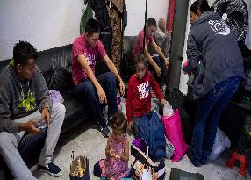
ADEQUATE
A residence that is sufficient for meeting both the physical & psychological needs typically met in a home environment. The residence has adequate privacy, space, security, electricity and lighting, access to running water, access to a working toilet, heating, and ventilation, etc.
Factors to consider:
How large is the residence? How many people reside at that location?
Is the family sharing a room? How many people share one room?
Where does the family sleep? Is it in a bedroom, or in a public area such as a dining room or living room?
Does the place have running water, electricity, and heat? Is there a basic functional part such as a working kitchen or a working toilet?
What is the condition of the place? Is it safe, warm and dry? Is there glass in the window panes? Are there holes in the structure? Is it infested with vermin or mold?

Slide 10








What does homelessness look like?
Doubled-Up/Shared Housing Students temporarily sharing the housing of friends or relatives due to the loss of housing, economic hardship or a similar reason
∇
Hotel/Motel Students temporarily living in a hotel or motel due to lack of adequate accommodations
∇
Unsheltered
Students living in abandoned buildings, campgrounds, vehicles, inadequate trailer parks, bus & train stations, substandard housing or abandoned in hospitals
Sheltered
Shelters, DV Shelters, Transitional Housing Programs
∇
Los Angeles County Office of Education
Notes:
JK

Slide 11

AND Unaccompanied Homeless Youth
Definition:
A child or youth who meets the McKinney-Vento definition of homelessness
and
is not in the physical custody of a parent or guardian.
Los Angeles County Office of Education

Slide 12

Key Provisions
District/Charter Homeless Liaison
Confidentiality (FERPA)
School of Origin (SOO) & School of Residence (SOR)
Immediate Enrollment
Equal Access
Transportation
AB 1806 (State Law)
Dispute Resolution Process

Slide 13
Local Liaison Duties
Ensures identified in coordination with others
Ensure immediate enrollment & access to services
Provide information about rights & opportunities
  Includes meaningful opportunities for parents to participate in their children’s education
  Includes transportation, school meals, & other programs
Ensure disputes are mediated
May affirm for Housing and Urban Development
Notes:
NCHE has a poster than can be downloaded or ordered from our website under the products and resources menu. (https://nchehelpline.org/)

Slide 14
Local Liaison Duties
Support in school selection & dispute resolution
Ensure UHY are provided verification of their status for FAFSA purposes
Provide training & other support for school personnel
Provide referrals to services in the community
Collaborate & coordinate services with State Coordinators, community and school personnel
  Includes collecting & reporting data
42 U.S.C. § 11434(g)(6)

Slide 15

School Selection
How do I determine what school to enroll my child in?
Under state and federal law, a student is eligible to:
  Continue at their School of Origin (the school attended when permanently housed or the school in which they were last enrolled) for the duration of homelessness; and includes any schools the student attended in the previous 15 months
  OR
  Enroll in any public school that students living in the same attendance area are eligible to attend (School of Residence)
15
Los Angeles County Office of Education
Notes:
ESSA enhances school stability with the presumption that school of origin is in the students best interest unless factors show otherwise

Slide 16

IMMEDIATE ENROLLMENT
What's needed to enroll in school?
Students in foster care or experiencing homelessness must be immediately enrolled in school and fully participating, even if they have missed application or enrollment deadlines.
Immunization and other health records*
Residency requirements including a letter from who they are living with or motel receipts
Birth certificates
School records, or other documentation
Outstanding fees or fines
Lost textbooks, technology devices or charges
Lack of IEP Paperwork
Uniform or dress code or school supply requirements
Guardianship issues
*Immunizations are required in the State of California. Medical Exemptions need to go through CDPH and their registry. Districts/Charters generally offer 30/40 window to obtain, after this students (even with McK status) must be excluded.
Los Angeles County Office of Education
Notes:
Enrollment Strategies
Training
Review and revise local policies
Utilize affidavits to help with enrollment
Collaborate with local agencies if family goes to them first
Coordinate with clinics or mobile health vans to address immunizations

Slide 17

Equal Access
Free & Reduced Breakfast and Lunch (automatic eligibility)
Summer School
Charter & Magnet Schools
Advanced Placement
Title I services or similar State or local programs
Gifted & Talented Programs
Special Education Services
English Learner Program/Services
Career & technical education
Before & After School Programs
Extracurricular Activities
Anything provided to their housed peers…
Los Angeles County Office of Education

Slide 18

Transportation: HOMELESS YOUTH
Can schools assist with transportation needs?
If it is a barrier it must be addressed
Districts/Charters determine the mode – they will generally start with internal bus routes and public transportation.
Transportation modes differ from district/charter to district/charter
District/Charters do have policies regarding when transportation would be provided (2/3 mile radius)
Only intended for school to home and home to school
Los Angeles County Office of Education

Slide 19
AB 1806 (State Minimum Course Requirements)
Students who transfer after their second year of high school can graduate by completing only state graduation requirements if they cannot reasonably complete additional local requirements within 4 years of high school
The State requires students to complete 130 credits in specific core courses
Once found eligible, the right continues even if a student transfers schools
Homeless youth: an unaccompanied youth may decide
  Must include info about the effect on admission to post-secondary school with the exception of any California Community College
If the youth is found ineligible, they may be reconsidered for eligibility at a later date.
AB 1166 – A student can be retroactively deemed eligible for the graduation exemption.
19
Notes:
BOTH
KT start with first bullet
AB1806 This bill will extend the following policies and procedures to students who are homeless that are currently afforded to foster youth:
Graduation requirements (AB 216)
Allows homeless students who enter a new high school after their second year or later to graduate if they complete state graduation requirements, unless the district finds that the student is reasonably able to complete the additional coursework in time to graduate by the end of the student’s fourth year of high school.
Notification is required within 30 calendar days of the date of entrance,
Notify re: how any of the requirements that are waived will affect the student’s ability to gain admission to a postsecondary institution
Provide information about transfer opportunities available through the California Community Colleges.
Exempt an eligible student at any time
Cannot revoke the exemption and Shall not require or request a student to transfer school in order to qualify for the exemption.
Completed coursework (SB 578)– allow partial credits
Expulsion (AB 1909)- notification to liaison
AB 1166: If district fails to provide that notification within 30 days, the homeless student may still qualify even if
notification is received after the termination of the court’s jurisdiction over the pupil or…
after the pupil is no longer homeless
If a homeless youth is exempted from local graduation requirements the exemption continues to apply:
after the pupil is no longer a homeless child or youth while he or she is enrolled in school or…
if the pupil transfers to another school or school district.

Slide 20
State Minimum Course Requirements
English
30 Credits
Math
20 Credits
Science
20 Credits
Social Science
30 Credits
VAPA, Foreign Language, or CTE
PE
20 Credits
10 Credits
Notes:
The State requires students to complete 130 credits in specific core courses:
3 years in English (can include 1 year of ELD if adopted by board)
2 years in Mathematics (INCLUDEs ALGREBRA 1)
2 years in Science (including Biological and Physical Sciences)
3 years in Social Studies (including U.S. History, World History, American Government, and Civics/ Economics)
1 year in Visual or Performing Arts, Foreign Language, or Career Technical Education (CTE courses if adopted by board)
2 years in PE (unless the pupil has been exempted)

Slide 21
Dispute Resolution
Addresses issues with eligibility, school selection or enrollment to the school of origin or the school of residence.
LEA must immediately enroll the student pending the resolution of the dispute.
The LEA must provide the parent/guardian with a written explanation of the enrollment decision as well as information regarding the LEA’s appeal process per policy.
The policy must include information to appeal to the county and to the state.
Any other issue for homeless youth enrollment may go through the LEAs Uniform Complaint Procedure.
#1 LEA Liaison
#2 County Liaison
#3 State Liaison
Dispute Process
Los Angeles County Office of Education
Notes:
If a dispute arises regarding school selection or enrollment, the school must immediately enroll the student pending the resolution of the dispute.
The LEA must provide the parent with a written explanation of the enrollment decision as well as information regarding the LEA’s appeal process per policy.
The policy must include information to appeal to the county and the state.
For Foster Youth (AB 1933)
Remain in school of origin until resolved
Liaisons – advisory role in placement decisions and determinations
Education rights holder has decision making authority

Slide 22
Special Education
IEP Related Question:
How can I get my child assessed when I am transient?
YES
NCHE Brief:
https://nche.ed.gov/wp-content/uploads/2018/10/idea_parents.pdf
If my child changes schools, should I tell the new school about the evaluation or an IEP from the last school?
Yes. Even if you do not have copies of the evaluation or IEP, you should tell someone at the new school as much as you can about your child’s evaluation or services at the last school she attended. This information will help the new school follow up to make sure your child continues in the evaluation process or receives services without an interruption in her education. Even if you never requested an evaluation at your child’s last school, if you think your child needs extra help, you should tell someone at the new school right away

Slide 23

IMPACT ON MENTAL HEALTH
SUICIDAL THOUGHTS
DEPRESSION
TRAUMA
SUBSTANCE ABUSE
ATTACHEMENT DISORDER
CONSTANT WORRY
LACK OF TRUST
ANGER
LACK OF EMPATHY
ANGER
LACK OF COMPASSION
GUILT
Los Angeles County Office of Education

Slide 24

STOMACH PROBLEMS
IMPACT ON
MEDICAL HEALTH
ASTHMA
LICE
UNDERTREATED ILLNESSES
POOR PHYSICAL
HEALTH
EAR INFECTION
INCOMPLETE HEALTH RECORDS
DENTAL
ISSUES
POOR COMMUNICATE
SPECIAL NEEDS AT BIRTH
INCONSISTENT DELIEVERY OF CARE
Los Angeles County Office of Education

Slide 25

ACEs affect health through STRESS – prolonged exposure to ACEs (like homelessness) can create toxic stress and damage the developing brain of a child & affect overall health
There are correlation between adverse childhood experiences (ACEs) & adult homelessness
Reduces the ability to respond, learn or figure things out, which can result in problems at school
Lowers tolerance for stress, which can result in behaviors such as fighting, checking-out or defiance
Increased difficulty in making friends & maintaining relationships
Increased problems with learning & memory, which can be permanent
Increased stress hormones which affects the body's ability to fight infection
May cause lasting health problems
Survival Mode Response to toxic stress increased a child’s heart rate, blood pressure, breathing and muscle tension. The “thinking brain” is knocked off-line. Self protection is a priority!

Slide 26
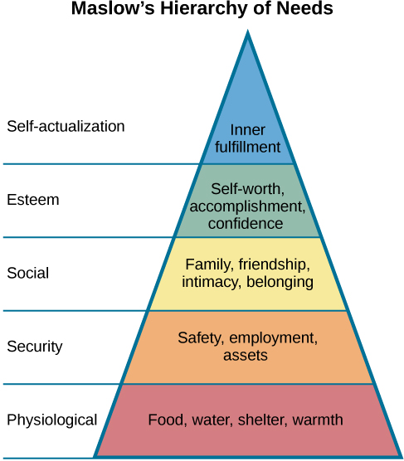
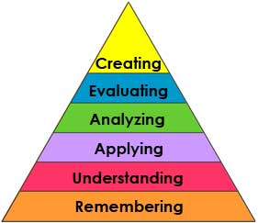

Intersection of Homelessness & Education
SCHOOL =
Sense of stability
Access to resources such as food
In-person human connection
Bloom’s Taxonomy
https://cft.vanderbilt.edu/guides-sub-pages/blooms-taxonomy/

Slide 27

Partnering with Schools
Complete the school Housing Questionnaires (HQ)
  Focused on housing type
  Required annually
Address
  Provide the best address
Share changes
  In address
  In status
Attend school
Collaborate on behalf of your child
Immunizations

Slide 28

Importance of an Education
A lack of high school degree is the biggest risk factor for experiencing homelessness as a young adult.
School may be one of the few stable places in a homeless student’s life and a location that can help with resources and support.
Positive school climates have shown to serve as a protective factor against any difficult effects of homelessness.
Education is the most important long-term strategy to addressing and preventing child and youth homelessness.
Education creates a sustainable living with a livable wage which can result in stable housing.

Slide 29
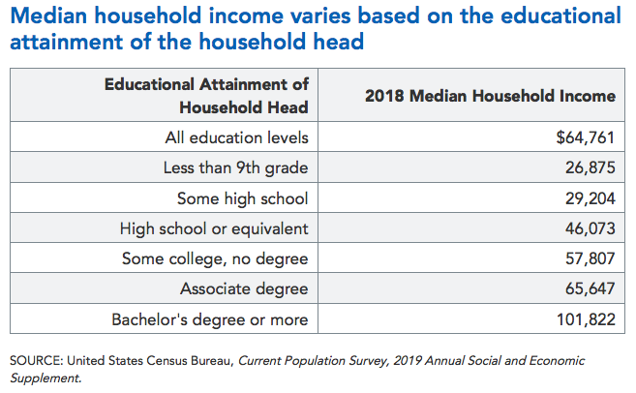
Median Income and Educational Attainment
Notes:
https://www.pgpf.org/blog/2019/10/income-and-wealth-in-the-united-states-an-overview-of-data

Slide 30
Parents Make the Difference
You are your child’s first and best teacher
Make sure your child goes to school every day and arrives rested and fed.
Provide a quiet place for your child to do homework, and set aside time every day to help your child with homework.
Pay attention to your child’s health needs and take care of any problems early.
Ask your child what he or she is learning in school. Have him or her explain it to you. If you show interest in your child’s education, he or she will know that it’s important.
Read to/with your child every day. For older children, set aside time each day for you and your child to read together silently. Talk about what you read.
Praise your child for what he or she does well, like getting a good grade or playing on a school sports team.
Listen to what your child shares with you and talk about any problems he or she is having. You also can talk about these problems with a teacher or school counselor.
Encourage your child to participate in things like sports and music.

Slide 31
Tips for Parents
Know your rights
Keep copies of critical records – immunizations, Social Security numbers, health records, IEPs. Ask someone to keep a set of these records for you, if needed
Maintain high expectations for your child and your child’s learning
Educate others
Know how to access resources in your area
Ask question – advocate for your self or seek out help:
  How can I connect with the District/Charter Homeless Liaison?
  Is transportation available for my child to say in the same school?
  Will someone help us transfer records quickly when we move?
  Is there a preschool program?
  Are there any special classed that would benefit a talent of my child?
  Is there a summer school program?
  Should my child be tested for special education?
  Are there sports, music, or other activities in which my child can participate?
  Can my child receive free meals at school?
  Are school supplies available?

Slide 32



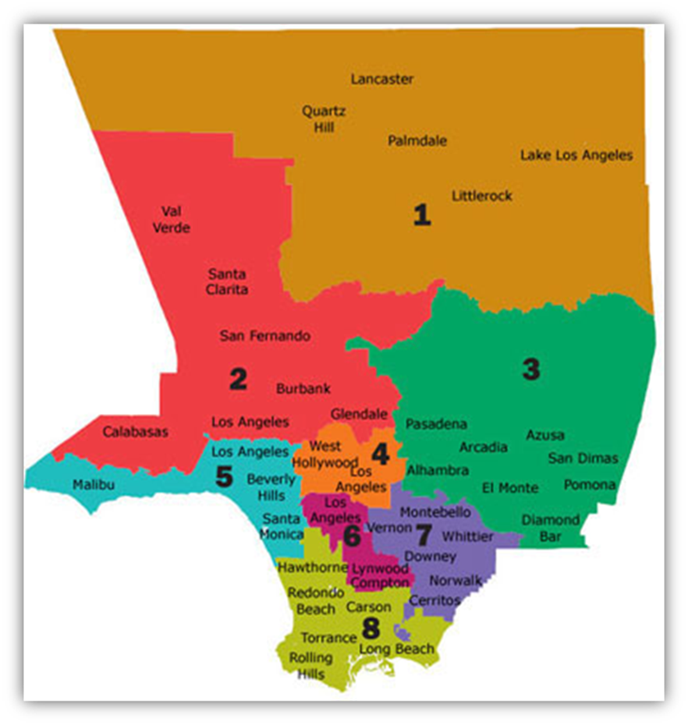
LACOE Coordinated Entry (CES) Program
Partnership Based
County-Wide System
Streamlined
Common database
Standardized Assessments
SPA-Based
Regional Resources/Needs
Lead CES for Youth & Family
Reduce Duplication
Maximize Resources
MEASURE H FUNDING
Notes:
Jen

Slide 33

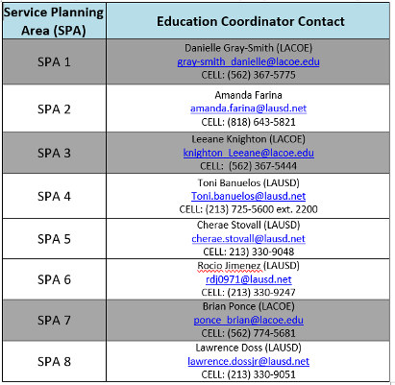
CES Lead Offices
Youth/Family Coordinated Entry System Assignments
Notes:
Jennifer

Slide 34



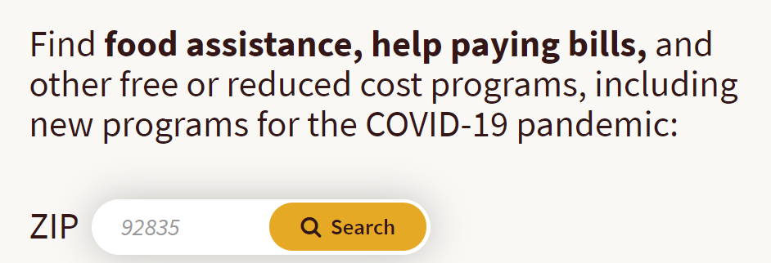
WIN APP – “What I Need”
RESOURCES
FINDHELP.ORG
Available in your App Store under
“What I need”
Los Angeles County Office of Education

Slide 35
Services WITHIN a District
Head Start/Early Head Start:
District preschool program
LACOE Head Start:
  https://www.lacoe.edu/Early-Learning/Head-Start
K-12:
District based tutoring
School On Wheels:
  https://schoolonwheels.org/need-tutoring/
Food:
Free & Reduced Lunch
LA County Regional Food Bank:
  https://www.lafoodbank.org/find-food/pantry-locator/
Mental Health:
National Alliance on Mental Illness:
  https://www.nami.org/Your-Journey/Teens-Young-Adults
LACOE Mental Health Information: https://www.lacoe.edu/Student-Services/School-Counseling
Child Care:
https://www.ccala.net/connect-to-child-care/
Technology Resources:
Free Phones: https://www.californialifeline.com/en
For School Counselors: https://www.counselora.com/
LA County Hotspot Locator: https://lacounty.maps.arcgis.com/apps/webappviewer/index.html?id=26159b0526e64bea94533e89da583b89
Connect with your district liaison to see what services your district provides
Notes:
Leeane

Slide 36
Services BEYOND a District
Coordinated Entry System (CES) & Los Angeles Homeless Services Authority (LAHSA):
https://www.lahsa.org/
College:
https://www.schoolhouseconnection.org/learn/higher-education/
Social Services:
DPSS: https://dpss.lacounty.gov/en.html
Homeless Shelter Directory: https://www.homelessshelterdirectory.org/california.html
LA County Homeless Shelter Locator: https://locator.lacounty.gov/lac/Search?&find=Homeless%20Shelters%20and%20Services&cat=49
General Services:
https://www.findhelp.org/ (general help support)
What I Need App – download from your App Store
  https://www.ourchildrenla.org/win-app/
Notes:
Leeane

Slide 37
Additional Resources
Brochures
English:
  https://nche.ed.gov/wp-content/uploads/2018/11/parentbrochure_eng.pdf
Spanish:
  https://www.flvs.net/docs/default-source/default/parentbrochure_sp.pdf?sfvrsn=242a462a_2

Slide 38

QUESTIONS AND DISCUSSION
Los Angeles County Office of Education

Slide 39


CONTACT INFORMATION
Dr. Jennifer Kottke
Homeless Education, Project Director II
Child Welfare and Attendance
Kottke_Jennifer@lacoe.edu
Notes:
KT

